Slide 1
What will happen to the Earth?
Results of 4 ESO survey

Slide 2
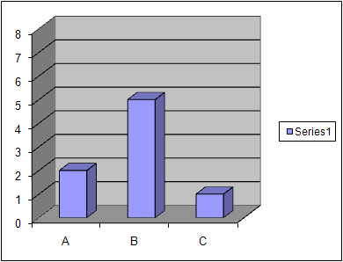
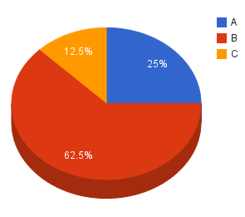
4. Will holograms exist in the future?
A.What’s that?
B.They already exist
C.No, they won’t

Slide 3
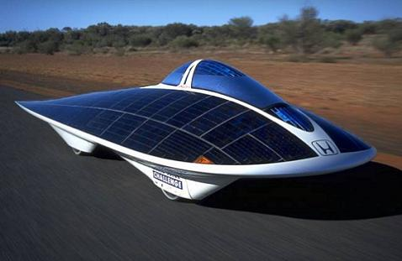
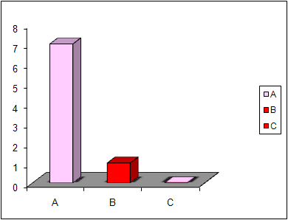
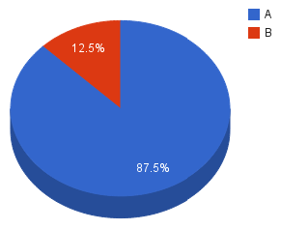
5. Do you think that cars will be powered by solar panels?
Yes I do.
No, never.
Probably.

Slide 4
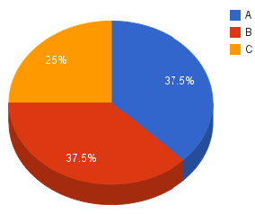
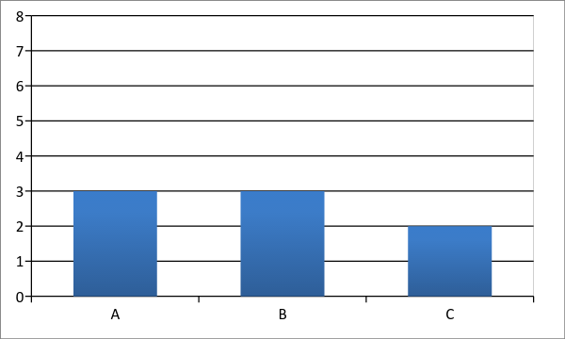
8. Experts are making another alternative to WIFI: LI-FI. People will surf the internet through light. Do you think we will use LI-FI in our homes?
A.Yes, we will.
B. I don’t know.
C. No, we won’t.

Slide 5
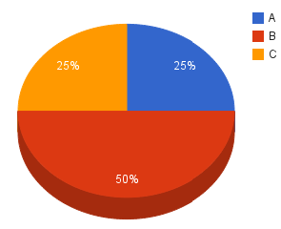
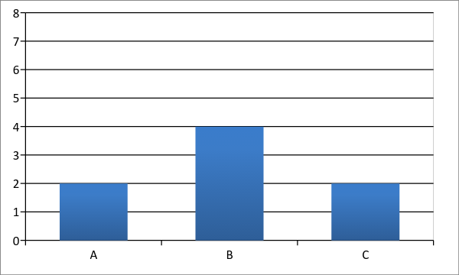
9. Will the Army use robots to transport materials?
No, because it will be too expensive.
Yes.
The Army will be formed by robots.

Slide 6
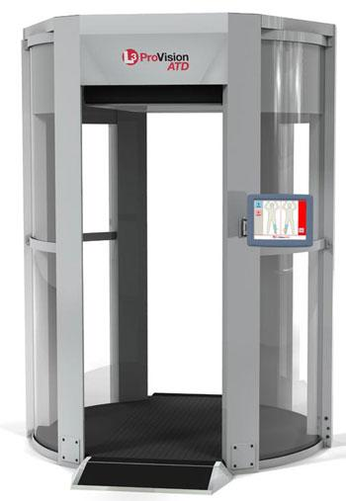
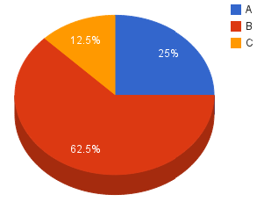
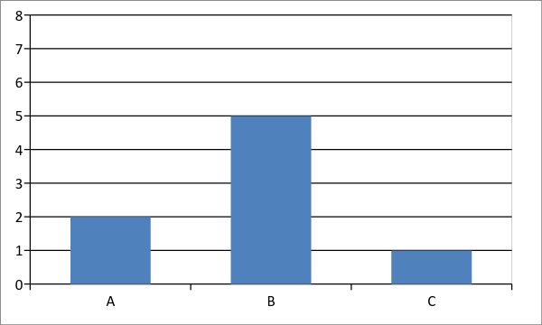
12. Do you think we will go into our houses with a body scanner?
Yes.
No.
I’m not sure.

Slide 7
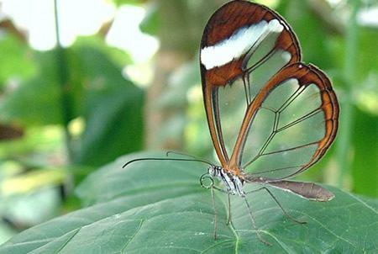
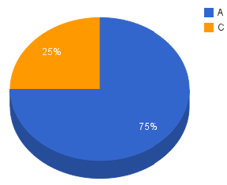
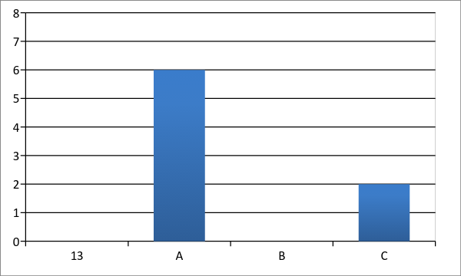
13. Will the evolution of technology destroy Nature?
Yes, it will.
No, it won’t.
I don’t know.

Slide 8
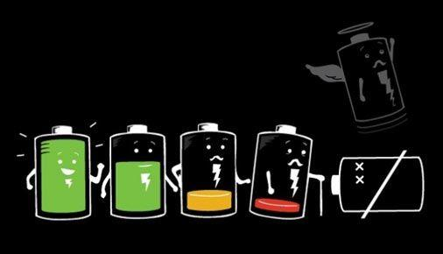
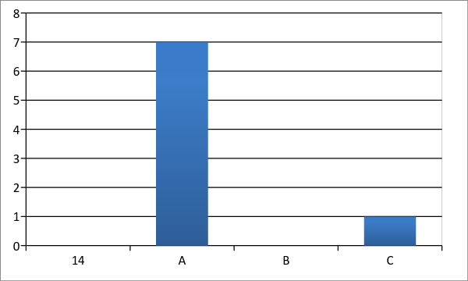
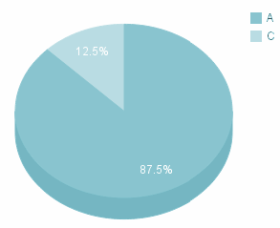
14. Do you think that electronic gadgets (iPods…) will be charged with the sun?
Yes, I do.
No, I don’t.
I don’t know.

Slide 9
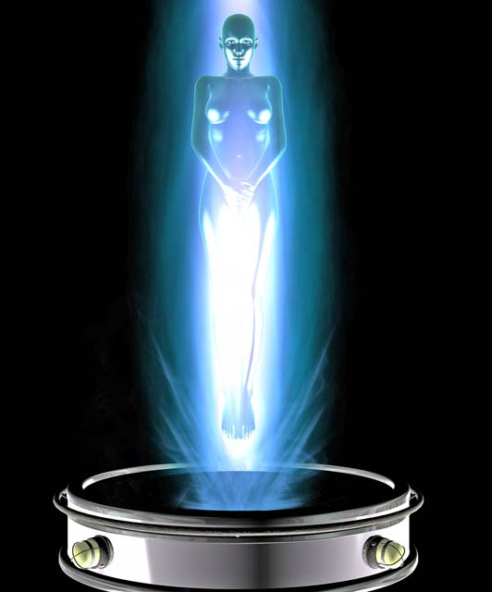
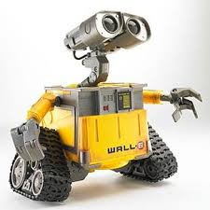
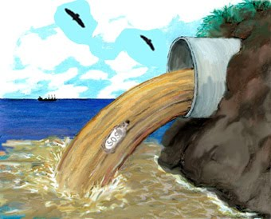
CONCLUSION

Slide 10
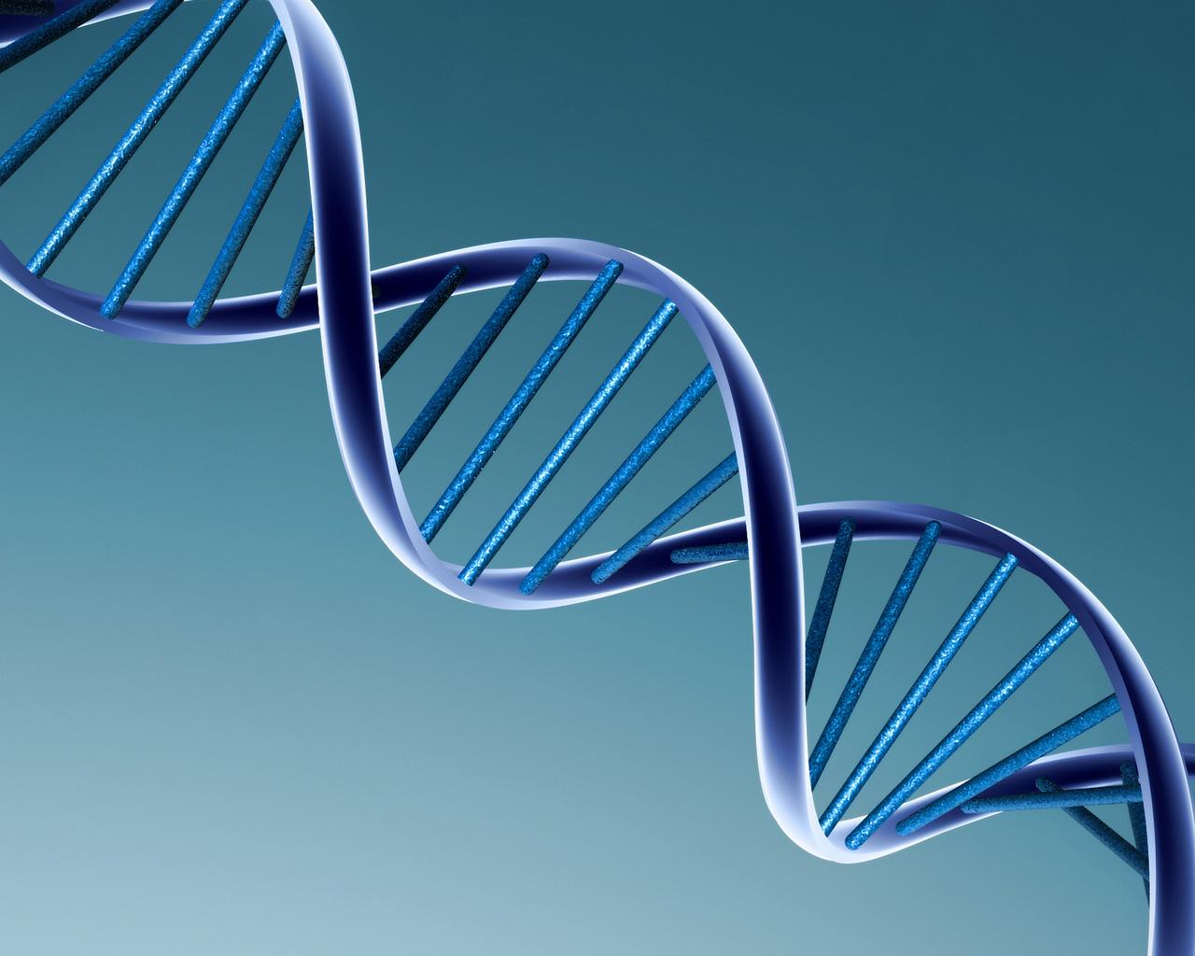
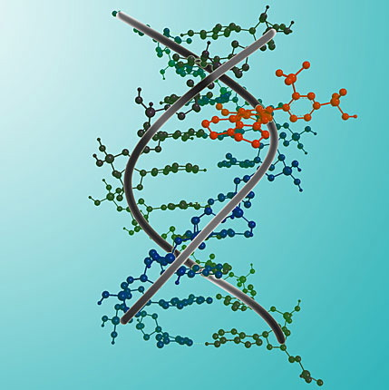
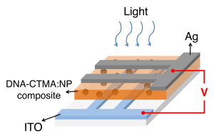
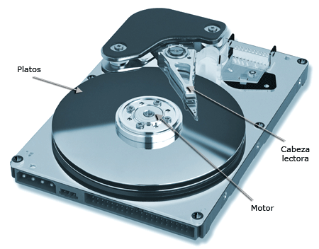
DATA STORAGE IN DNA
silver nanoparticles
DNA of salmon
memory support
similar to an optical disc
UV LIGHT: Write
LASER: read

