Slide 1
The Future Of The Earth

Slide 2
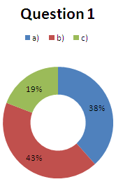
Do you think that in the future houses will be built with 3D printers?

Slide 3
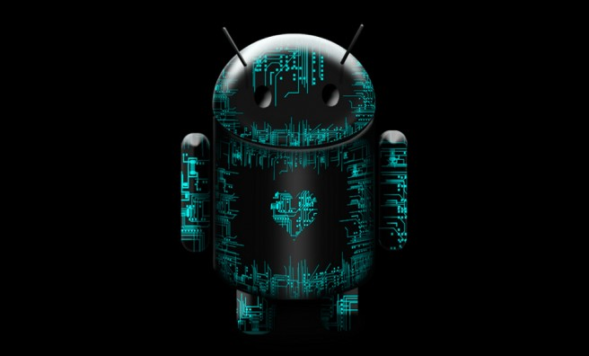
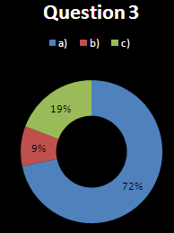
Do you think that telephone batteries won’t run down?

Slide 4
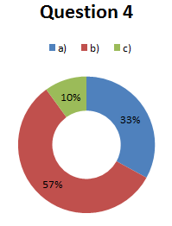
Will holograms exist in the future?

Slide 5
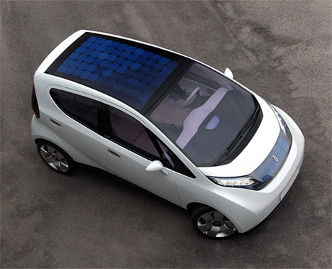
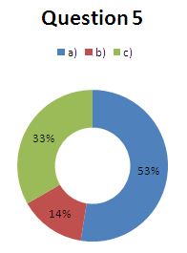
Do you think that cars will be powered by solar panels?

Slide 6
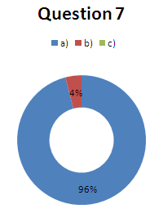
Do you think that we will control computers with our voice?

Slide 7
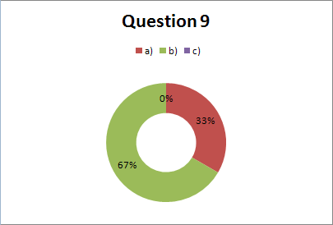
Will the Army use robots to transport materials?

Slide 8
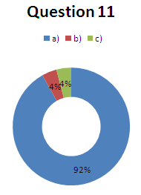
Do you think that there will be a bionic eye to the blind people?

Slide 9
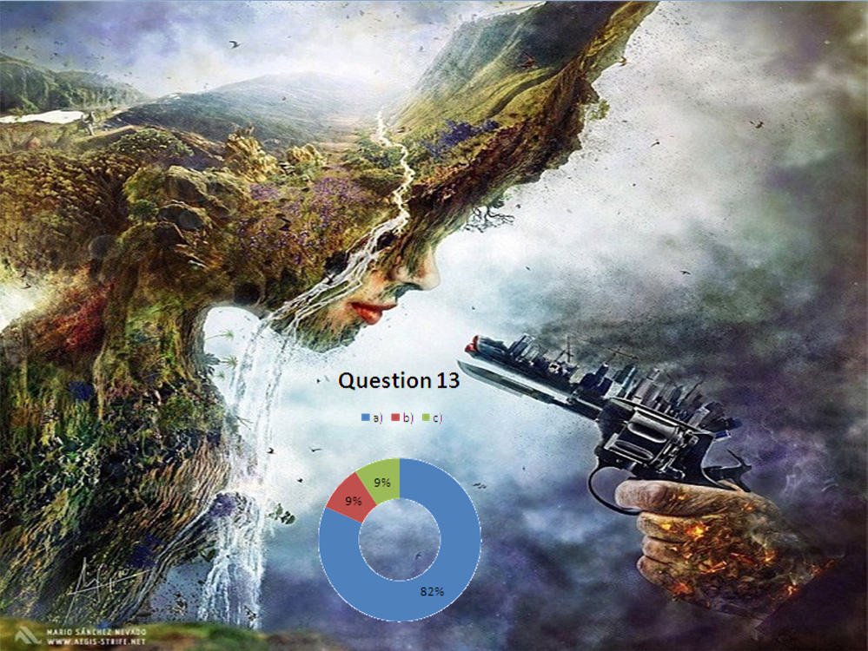
Will the technology destroy NATURE?

Slide 10
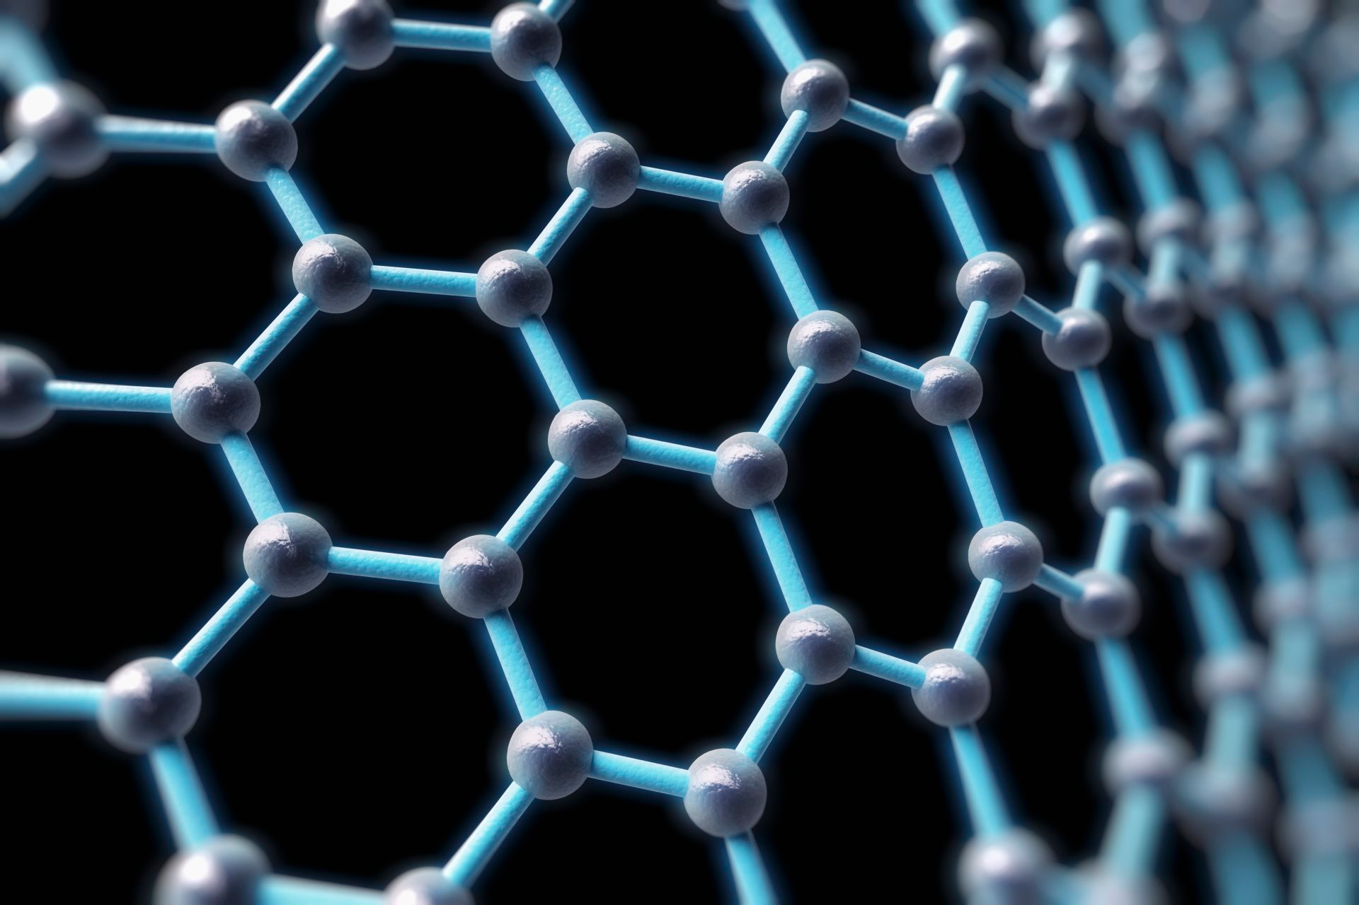
Grafeno
It is flexible
It is the hardest material
It carry electricity
It can create electricity thit the sun power

