Slide 1
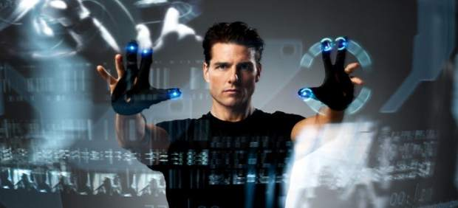
TECHNOLOGIES IN THE FUTURE. LIGHT AND DARKNESS

Slide 2
Do you think that the telephone batteries won’t run down?
A | Probably
B | Impossible
C | Nobody knows

Slide 3
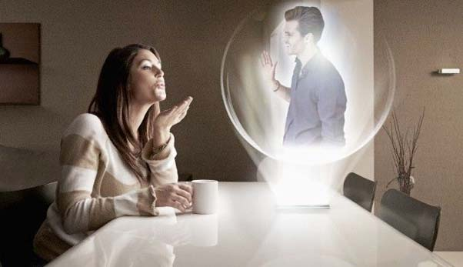
Will holograms exist in the future?
A | What´s that
B | They already exist
C | No, they won´t

Slide 4
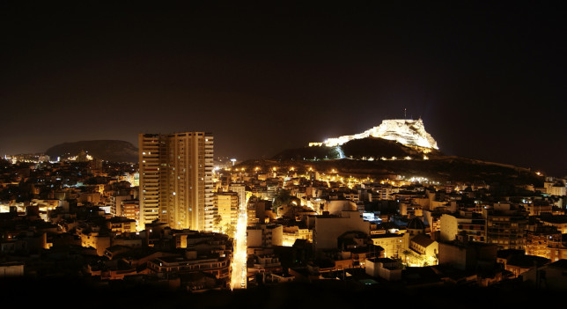
One day we won’t see the sky by the great amount of light that there will be?
A | Darkness won´t dissapear
B | That will Probably happen
C | I agree

Slide 5
Do you think that we will control computers with our voice?
A | Yes, because nowadays we can do it with our voice
B | No, it will be impossible
C | Maybe, but only for surfing the internet

Slide 6
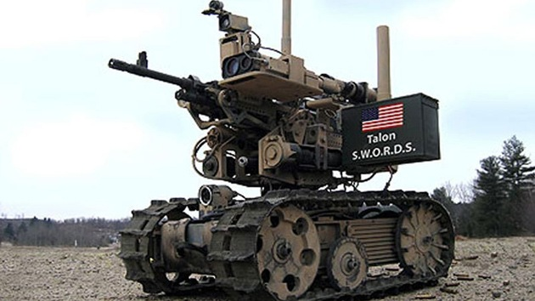
Will the Army use robots to transport materials?
A | No, because it will be too expensive
B | Yes
C | The army will be formed by robots

Slide 7
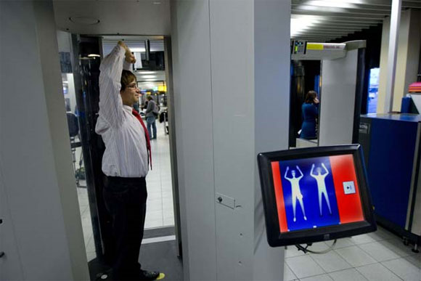
Do you think we will go into our houses with a body scanner?
A | Yes
B | No
C | I´m not sure

Slide 8
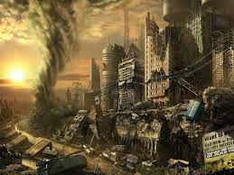
Will the evolution of technology destroy nature?
A | Yes, it will
B | No, it won´t
C | I don´t know

Slide 9
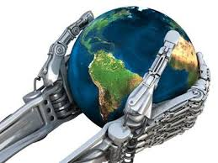
CONCLUSION
We think that the students have ideas clear about the future and think that technology will destroy the world

Slide 10
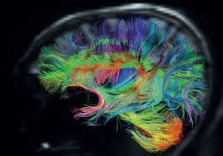
BRAIN CONNECTOME
It is an artificial brain that helps people with brain diseases. Is a breakthrough technology and human life

Slide 11
BY:
Roxana Raluca Matache
Carmen María Vera Henarejos
Alba Maribel Paza
Alicia Villena
Toa Remache

